Slide 1
Programming for Engineers in Python
Fall 2019-2020
Recitation 1: Introduction to Python

Slide 2
Plan
Administration:
Course site
Homework submission guidelines
Python:
Working environment
Editor vs. shell
Variables
Operators
Conditional Statements (if / elif / else)
Discuss Homework 1

Slide 3
Administration
Course website: http://www.cs.tau.ac.il/courses/pyProg/1920a/
All course material: Lectures, Recitations, Code Examples
Homework guidelines and solutions
Announcements
Instructions (e.g. how to install stuff at home)
Details of course staff
Moodle: https://moodle.tau.ac.il/course/view.php?id=509182099
HW submission and grades
Forum

Slide 4

Administration
Homework
Very important when learning to program!
See Exercises tab in course website for guidelines.
Where can I work?
Computer labs
Time and location appear in the course website
Back-up with email / disk-on-key
/ dropbox / etc. !

Slide 5
Administration
Submission Guidelines
Submission in singles!
Strict submission dates.
File MUST work – provide results by running the file (F5)
Must work on Python 3.7
No cheating!
Guidelines in the course website.

Slide 6

Working Environment
We will work with Python 3.7, not Python 2.x.
Install Anaconda (at home):
https://www.anaconda.com/distribution/#download-section
Choose Windows / OSX / Linux
Choose Python 3.7
Choose 64-bit / 32-bit Which one do I run?
Open:
Navigate to C:\Program Files\Anaconda\Scripts (installation directory)→ run idle.exe to open Idle terminal
It is recommended to create Desktop shortcut:
right click on idle.exe, Send to → Desktop (create shortcut)

Slide 7
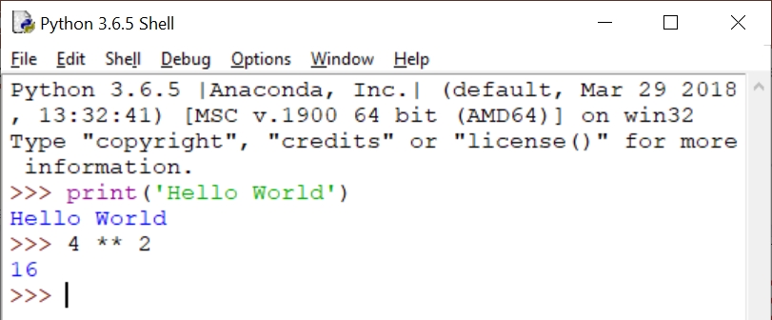
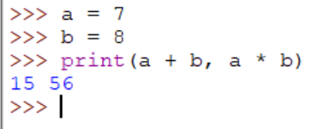
IDLE Shell
The Python shell is convenient for testing:
Individual statements.
Short code snippets.
The shell isn’t meant for writing complete programs.

Slide 8
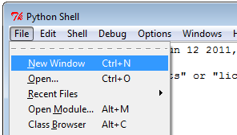
IDLE Editor
We want to save a sequence of commands and run it later in a new Python session.
The Editor:
- Write a sequence of Python commands
- Execute them in one key-press. (F5)
Open the editor from
the Shell:
File →
New Window

Slide 9
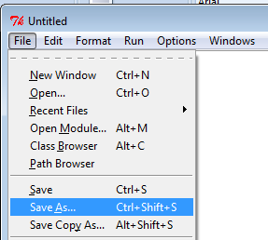
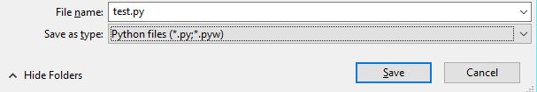
IDLE Editor
In the new window: File → Save as…
Choose a folder and a name. The name must end with ‘.py’

Slide 10
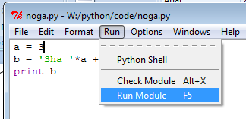
IDLE Editor
Run code:
The output appears in the Shell window (a new Shell might open)

Slide 11
What are Variables ?
A value in the computer’s memory.
has a name (for program access)
refers to a block in memory that holds some value
has a type – according to its value
This is how data is handled:
In Program:
some_variable
In Memory:
01000001
01000010
01000011
01000100
int
str
float
In Program, Interpretation by Type:
1094861636
'ABCD'
12.141422

Slide 12
Warm-up 1: Numeric Types
>>> x = 7
>>> type(x)
<class 'int'>
>>> y = 2.71828
>>> type(y)
<class 'float’>
Question: What is the value and type of:
16 / 3 , 16 // 3 , 16 % 3 , 2 + 2.5 , 2 + 2.0 ?
Arithmetic operations:
+ - * / % (modulo) // (integer division) ** (power)
integer type
floating point ("reals") type

Slide 13
Variables and Assignments
variable expression
>>> =
Assignment
1. First evaluate the expression
2. Then assigns the value to the variable
A variable's name is a sequence of letters, digits and underscores (‘_’), starting with a letter

Slide 14
Warm-Up 2: Variables and Assignments
>>> n = 5*2
>>> m = n*3+2
>>> print(m)
32
>>> n = 6
>>> print(m)
???
n
m
10
32
n
m
6

Slide 15
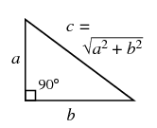
Example 1
Write a code that receives the length of the two legs of a right triangle, a and b.
Calculate the length of the hypotenuse, c
Calculate the triangle’s area
Calculate the triangle’s circumference
Print all three values

Slide 16
Exercise 1
a = ??? #replace the ??? With a positive number
b = ??? #replace the ??? With a positive number
#write your code here

Slide 17
Exercise 1
a = 3 #replace the ??? With a positive number
b = 5 #replace the ??? With a positive number
#write your code here
c = (a**2 + b**2)**0.5
area = (a * b) / 2
circum = a + b + c
print(c, area, circum)

Slide 18

Program Readability
Real computer programs include thousands of code lines, lots of variables.
Readability is very important for code maintenance.
The next slide list some programming conventions that are crucial
for readability.

Slide 19
Program Readability – cont.
Choose informative variable names:
Are i, j, m , n informative names?
Depends on context.
Comments:
option 1: begin with # (until end of line)
option 2: surrounded by """ (3 double quotes) when spanned over multiple lines
Documentation is most important before ‘logical units’ or complex implementation.
w | sm | a_string | Not informative:
word_count | sum_of_expenses | student_name | Informative:

Slide 20

Strings
An ordered collection of characters.
In Python, string constants can be enclosed in either 'single quotes' or "double quotes".
Choose between the quotes at your convenience: "Here's one example." 'She said: "this is cool".'
o | l | l | e | H
0
1
2
3
4
-5
-4
-3
-2
-1

Slide 21

Strings – Cont.
>>> mssg1 = "Let there"
>>> mssg1[0]
'L'
>>> mssg1[2].upper()
'T'
>>> mssg2 = " be light"
>>> mssg1 + mssg2
'Let there be light'
>>> len('abcde')
5
>>> mssg1 + mssg2 * 3
'Let there be light be light be light'
>>> str(5)
'5'
>>> int('5')
5

Slide 22
Strings Slicing
>>> some_str[x:y:z]
Returns a new string based on characters
from some_str:
from position x (including)
until position y (not including)
with steps of size z
Example:
>>> 'hello python'[1:10:2]
'el yh'
1,3,5,7,9

Slide 23
Strings Slicing
>>> some_str[x:y:z]
If z is missing (some_str[x:y] or
some_str[x:y:])
The slice is with steps of size 1
If y is missing (some_str[x::z])
The slice is until the end of some_str
If x is missing (some_str[:y:z])
The slice is from the beginning of some_str

Slide 24
Exercise 2
Write a code that receives a string s with only lower letters, and prints a similar string, but with the middle letter in an upper case format.
efghij
efghi
efgHij
efGhi

Slide 25
Exercise 2
s = ??? #replace the ??? With a string
#write your code here
Hint: len(s) returns the strings length

Slide 26
Exercise 2
s = 'efg' #replace the ??? With a string
#write your code here
n = len(s)# find string’s length
middle = n / 2 # find string’s middle index
middle_letter = s[middle]
# find string’s middle letter
s[middle+1:len(s)]

Slide 27
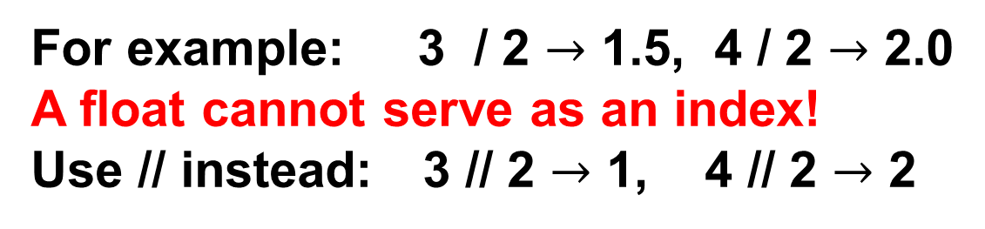
Exercise 2
s = 'efg' #replace the ??? With a string
#write your code here
n = len(s)# find string’s length
middle = n / 2 # find string’s middle index
middle_letter = s[middle]
# find string’s middle letter
s[middle+1:len(s)]
For example: 3 / 2 $→$ 1.5, 4 / 2 $→$ 2.0
A float cannot serve as an index!
Use // instead: 3 // 2 $→$ 1, 4 // 2 $→$ 2

Slide 28
Exercise 2
s = 'efg' #replace the ??? With a string
#write your code here
n = len(s)# find string’s length
middle = n // 2 # find string’s middle index
middle_letter = s[middle]
# find string’s middle letter
U_middle_letter = middle_letter.upper()
new = s[0:middle] + U_middle_letter +
s[middle+1:len(s)]

Slide 29
Exercise 2
s = 'efg' #replace the ??? With a string
#write your code here
n = len(s)# find string’s length
middle = n // 2 # find string’s middle index
middle_letter = s[middle]
# find string’s middle letter
U_middle_letter = middle_letter.upper()
new = s[0:middle] + U_middle_letter +
s[middle+1:]
print(new)
This means until the end

Slide 30
Comparisons
Comparison operators:
== (Note: twice ‘=‘, this is not assignment)
!=
> < >= <=
Comparisons evaluate to Boolean (bool) values:
True or False.
Can be chained:
>>> a = 6 < 7 < 5
>>> a
False
>>> b = 1>6 or 3<4
>>> b
True

Slide 31
Variables - Summary
We saw the types int, float, str, bool.
Assignments: variable_name = expression
Subsequent assignments to the same variable can change its value and even its type.
Some operations allow "mixing" variables of different types, e.g. 'hi' * 2.
Booleans:
True and False are boolean constants.
Boolean expressions through or / and / not.
Comparisons yield boolean values.

Slide 32
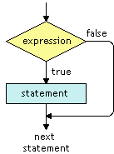
Conditional Statements, if
if condition:
do something
Indentation!

Slide 33
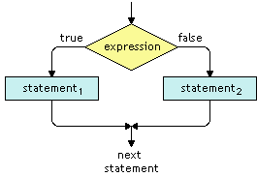
Conditional Statements, if-else
if condition:
statements₁
else:
statements₂
Indentation!

Slide 34
if Example
if 54 % 18 == 0: # the remainder of 54 divided by 18
print("54 is divisible by 18")
print("54 is also divisible by 2 and 3")
54 is divisible by 18
54 is also divisible by 2 and 3

Slide 35
if-else Example
if 'cat' < 'dog':
print("'cat' comes before 'dog'")
else:
print("'dog' comes before 'cat'")
'cat' comes before 'dog'

Slide 36
if-else Example
if 'cat' < 'dog': # compared lexicography
print("'cat' comes before 'dog'")
else:
print("'dog' comes before 'cat'")
Note how each of if and else has its own indented statements under its own block.
'cat' comes before 'dog'

Slide 37
Conditional Statements, if-elif-else
if condition1:
statements1
elif condition2:
statements2
elif condition3:
statements3
else:
statements4
Indentation!

Slide 38
if-elif-else Example
my_chips = 108
your_chips = 80
if my_chips > your_chips:
print("I won :-)")
elif your_chips > my_chips:
print("You won :-(")
else:
print("It's a tie :-O")
I won :-)
Each of if, elif, else has its own indented
statements.
Notes:
What if we change elif to if

Slide 39
Nested Conditional Statements
if n % 2 == 0:
else:
print(n, 'is not divisible by 2.')
Indentation!

Slide 40
Nested Conditional Statements
if n % 2 == 0:
if n % 5 == 0: # NESTED if
print(n, 'is divisible by 2 and by 5,
so also by 10.')
else: # NESTED else, pertains to NESTED if.
print(n, 'is divisible by 2 but not by 5.')
else:
print(n, 'is not divisible by 2.')
Indentation!

Slide 41
Nested Conditional Statements
if n % 2 == 0:
if n % 5 == 0: # NESTED if
print(n, 'is divisible by 2 and by 5,
so also by 10.')
else: # NESTED else, pertains to NESTED if.
print(n, 'is divisible by 2 but not by 5.')
else: # Not nested, thus pertains to FIRST if.
print(n, 'is not divisible by 2.')
What will be printed when n = 20?
20 is divisible by 2 and by 5, so also by 10.
What will be printed when n = 22?
22 is divisible by 2 but not by 5.
What will be printed when n = 25?
25 is not divisible by 2.
Indentation!

Slide 42
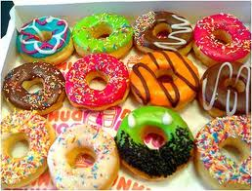
Exercise 3
Donuts:
Input: Define a variable named donuts and assign to it some number (of donuts).
Output:
If donuts is no more than 5, print 'Number of donuts: donuts.'
Otherwise, if donuts is no more than 10, print 'Number of donuts: donuts...'
Otherwise, print 'Number of donuts: a lot!'
Note: the trailing '.' / '…' / '!' must be printed without any space before them.
Run your program. Examples are in the next slide.

Slide 43
Exercise 3
Examples:
For 5 donuts you should get:
Number of donuts: 5.
For 9 donuts you should get:
Number of donuts: 9...
For 23 donuts you should get:
Number of donuts: a lot!

Slide 44
Exercise 3
donuts = ??? #replace the ??? With a positive number
#write your code here

Slide 45
Exercise 3
donuts = 7 #replace the ??? With a positive number
#write your code here
if donuts <= 5:
print('Number of donuts:', str(donuts) + '.')
elif donuts <= 10:
print('Number of donuts:', str(donuts) + '...')
else:
print('Number of donuts: a lot!')

Slide 46
Home Assignment – Discussion
Let’s download homework #1 from the course website and review it.
Then, we’ll show how to submit the homework in Moodle.

Slide 47
“My Code doesn’t Work!”
Go over your code carefully.
Consult course slides.
Google (a useful and legitimate source).
Good forums to ask questions online:
stackoverflow.com, underwar.co.il
Check the public forum in Moodle.

Slide 48
Understanding Errors
Traceback (most recent call last):
File "C:\Users\John\Desktop\blah.py", line 2, in <module>
b = 2 / a
ZeroDivisionError: integer division or modulo by zero
Where in your program?
The last line of the error is most informative.
>>> check_this
Traceback (most recent call last):
File "<pyshell#16>", line 1, in <module>
check_this
NameError: name 'check_this' is not defined

